Slide 1
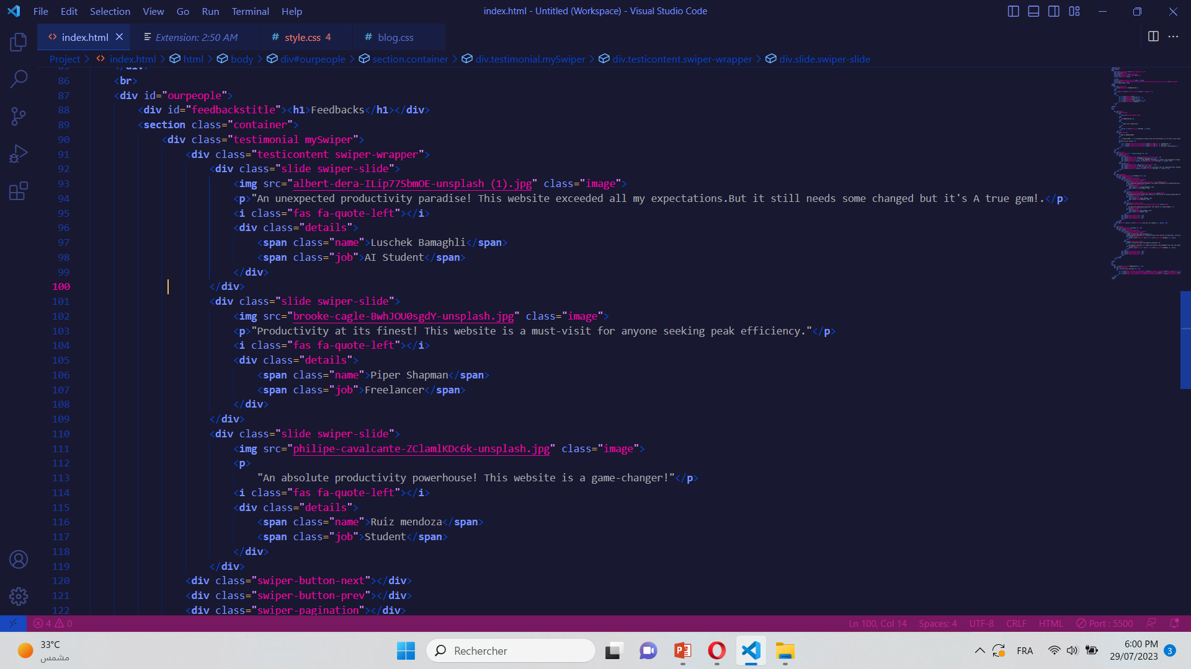
PRODUCTIVEME
By:Anaghim Mechergui

Slide 2
PRESENTING MYSELFF
I’m Anaghim Mechergui , a computer science student who’s interested in web development and big data.Creating this website was challenging and I’m looking forward to optimize my skills and learn new ones.

Slide 3
PROJECT IDEA
01
PROJECT GOALS
02
WEBPAGES DEVELOPED
PLAN OF THE PRESENTATION
03
DIFFICULTIES
CLOSURE
How did I get the idea to create the website
What’s the point from this website
The webpages and their advantages
More details
04
05

Slide 4

PROJECT IDEA
01

Slide 5

PRODUCTIVE ME
I got inspired to create this website after the last task we finished « Todo list using js ».
Basically,PRODUCTIVE ME is a minimalistic website that minimizes distractions and that’s obvious by using simple features,non vibrant colors such as gray,dark purple,baby blue.. And simple icons.
COLORS
#b489b2
LOGO
#b489b2
#ab60dc
#0bbcdb
#bcbbbe
#b489b2
#35044A

Slide 6
PROJECT GOALS
02

Slide 7
OPTIMIZE FOCUS AND KNOWLEDGE
BE MORE ORGANIZED
WHAT WE ARE WORKING ON
FINISH TASKS
BE FLEXIBLE
About focus,minimizing colors and icons will help the user actually focus on their productivity.The blogs we provided on pur website contain pieces of advice and useful tricks to hack your mind and be more productive.
Using our services:Pomodoro technique and tado list you can be more organized and that will help you achieve 100% of your potential.
Being more organized helps you actually finish your tasks easily and rapidly.
You can use our website anytime you want andi if the luminosity bothers you you can use night mode.

Slide 8
WEBPAGES
03

Slide 9
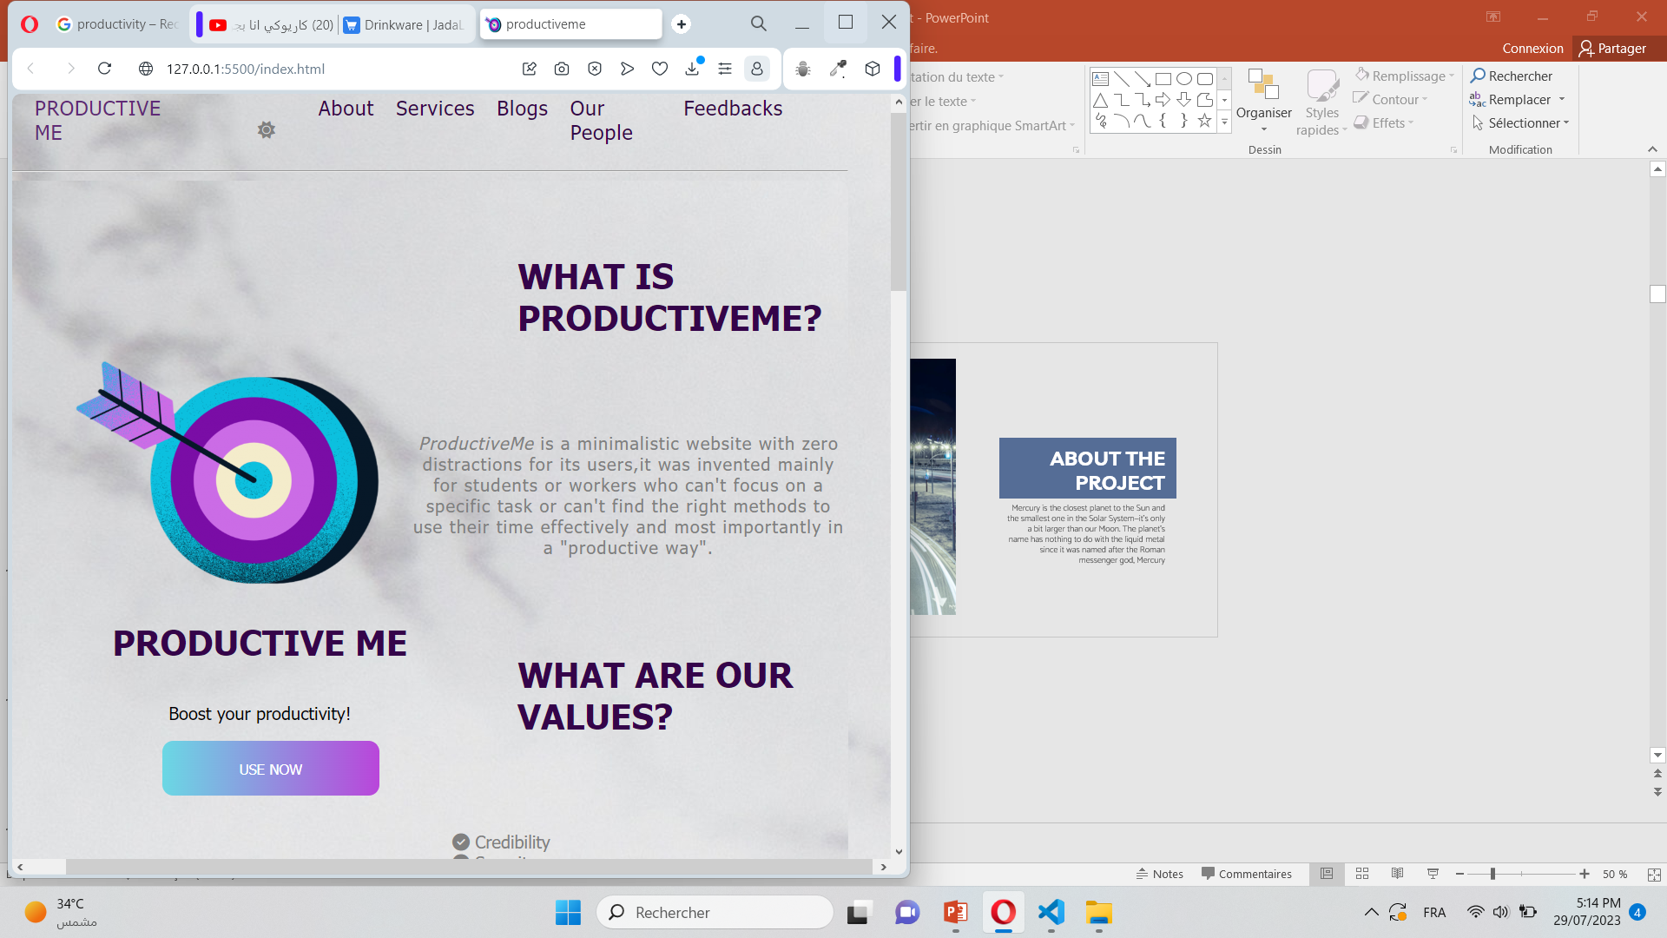
THIS IS OUR HOME PAGE
You can access each part of this page by clicking on the different features provided in the nav bar.You can also give us your feedback if you click on feedbacks or turn to dark mode by clicking on the sun icon.
To stay in touch,you ca contact us through the icons we provided at the bottom of the webpage.

Slide 10
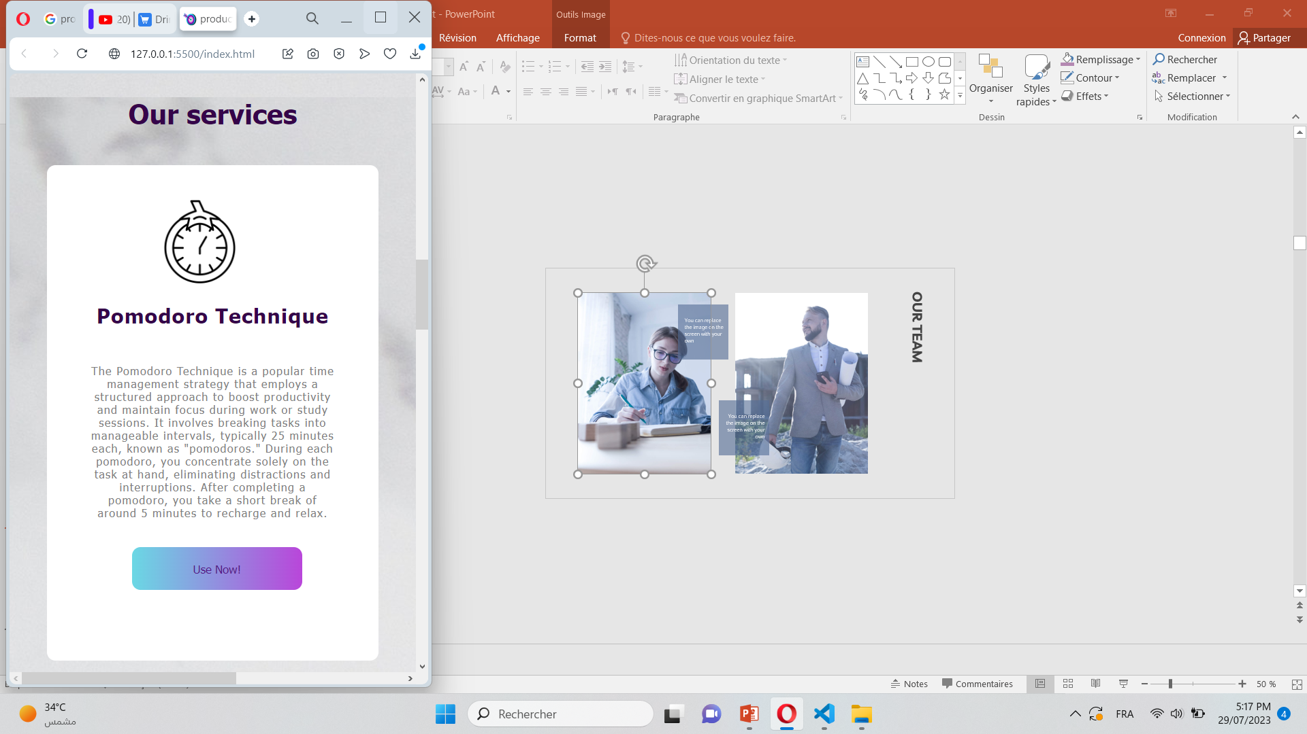
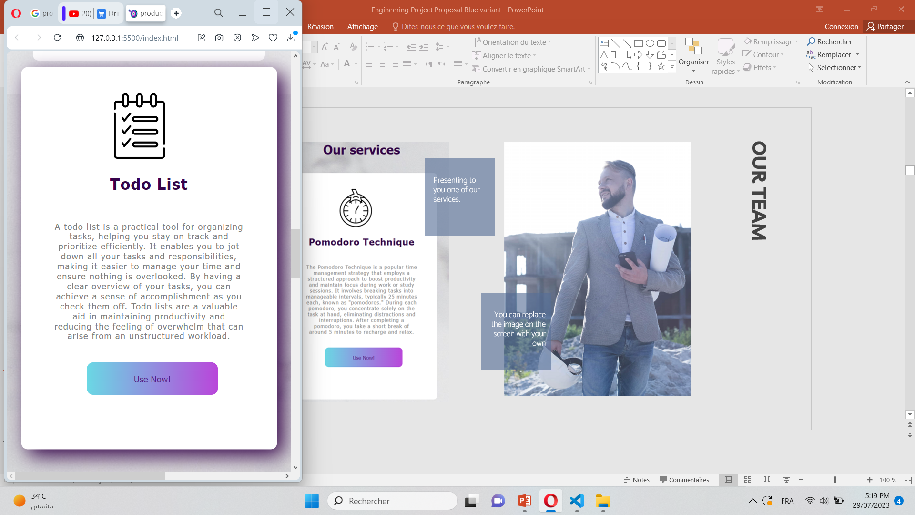
OUR SERVICES
Pomodoro technique is one of our services
A todo list is one of our services

Slide 11
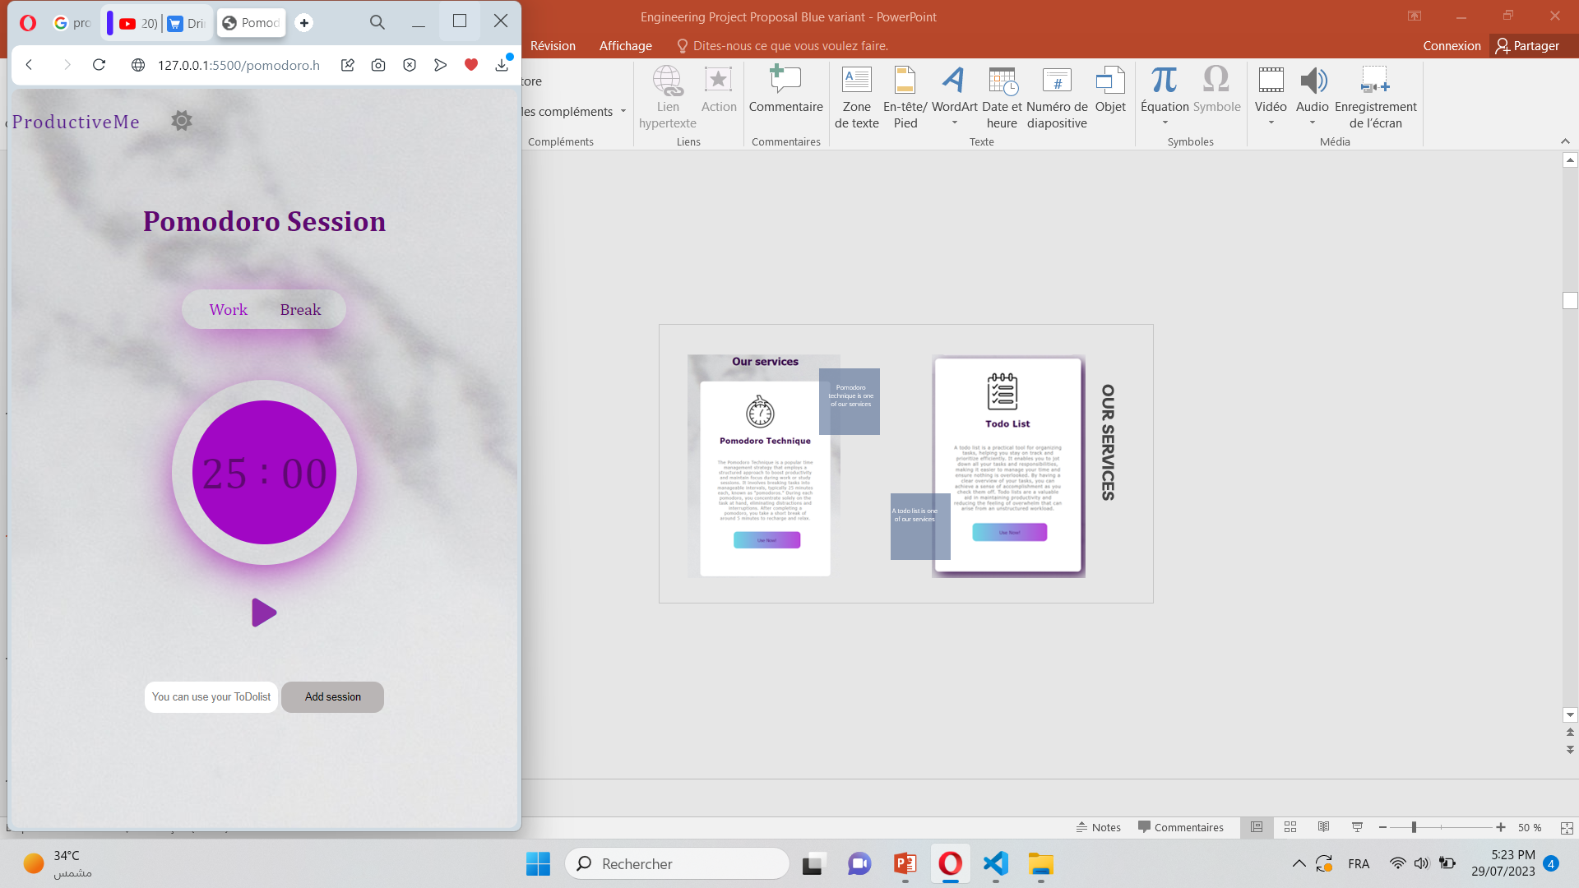
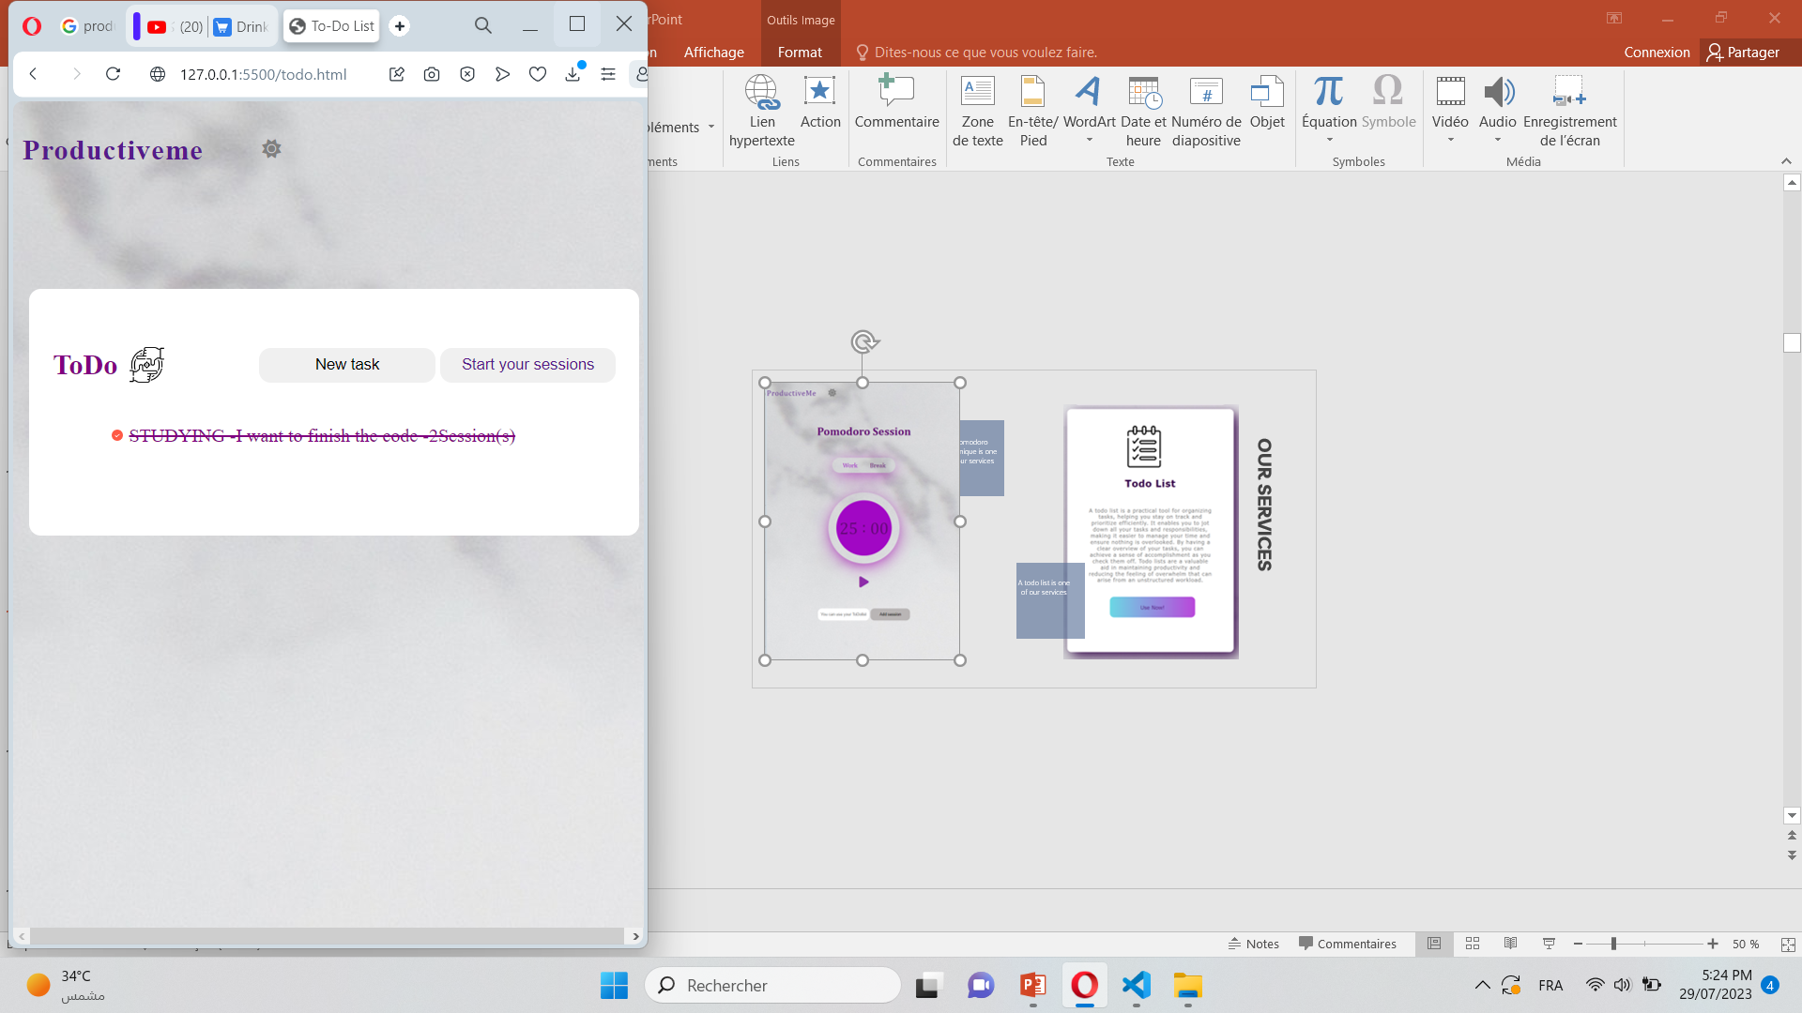
OUR SERVICES
You can start your session by naming it(you can use the todo list to see what sessions you will work on)then use the timer.you can also put it in dark mode.
You can add whatever task you want to accomplish,give it a title,few details and how many sessions you will need then press start your session to take you to the next service(Pomodoro technique).

Slide 12
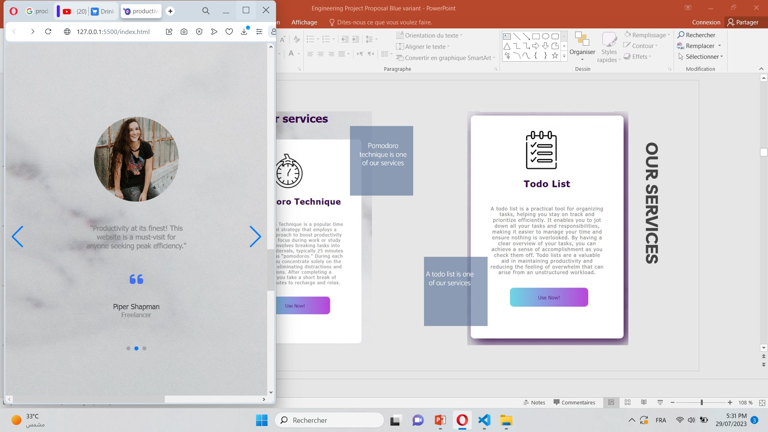
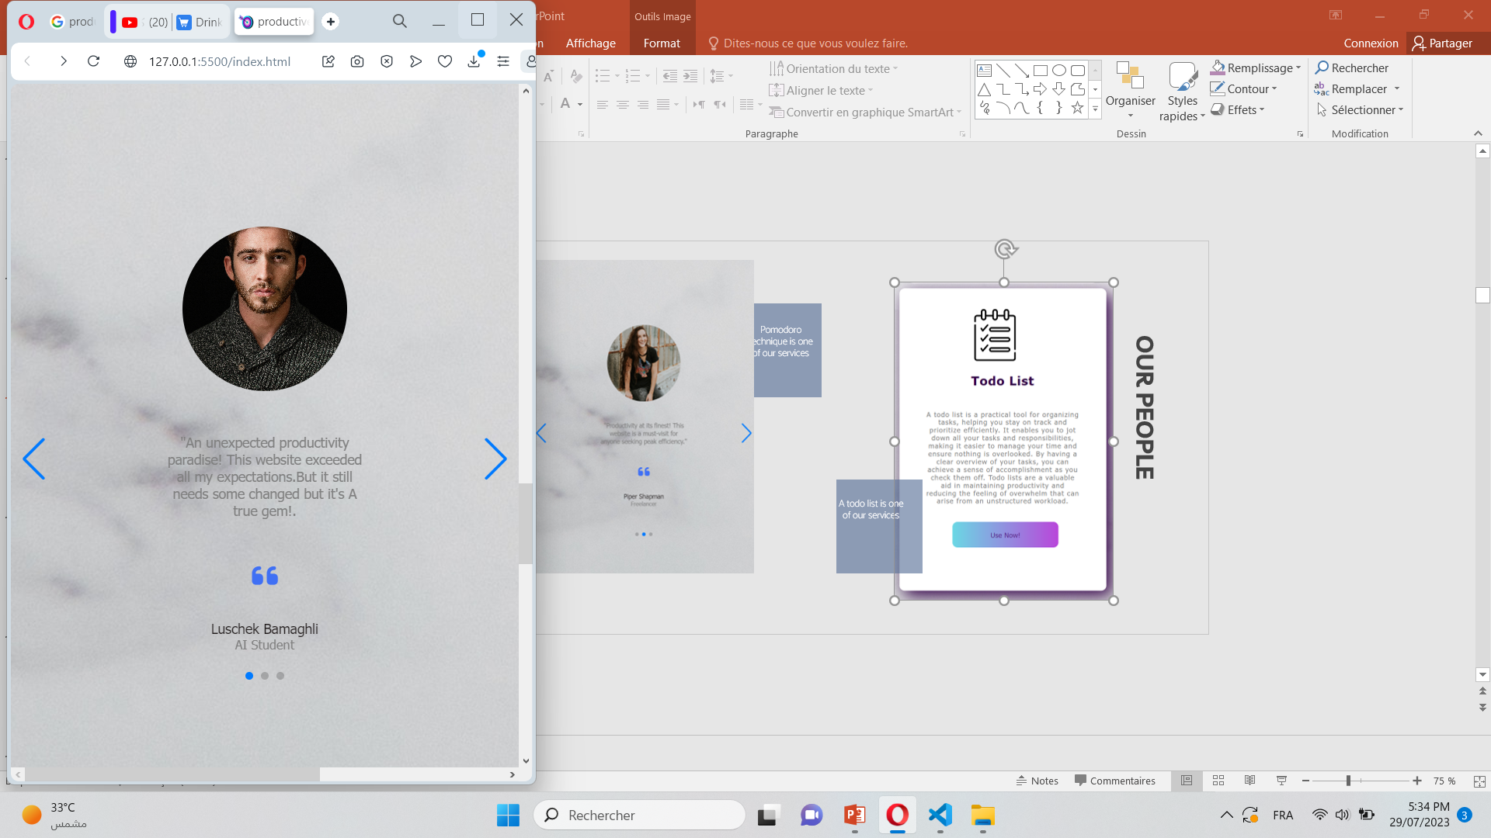
OUR PEOPLE
These are the feedbacks of some of the users of our website.

Slide 13
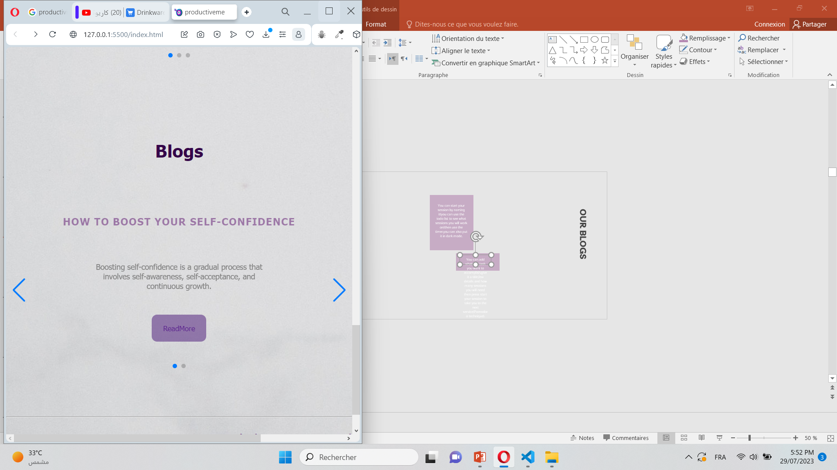
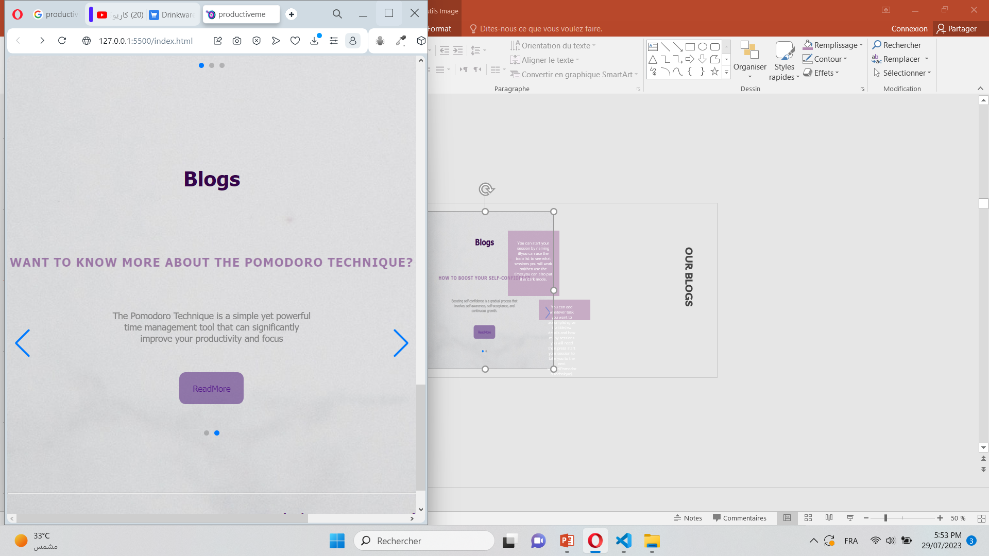
OUR BLOGS
A blog about boosting self confidence.
A blog about using one of our services:Pomodoro Technique timer

Slide 14
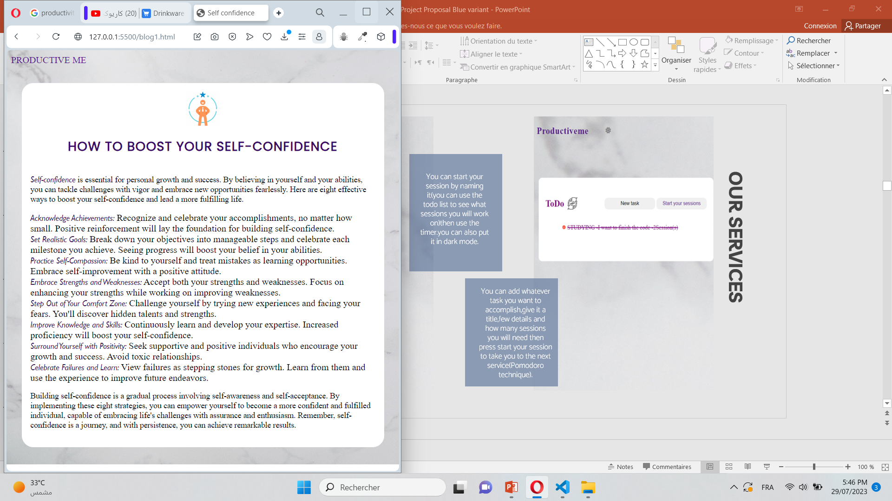
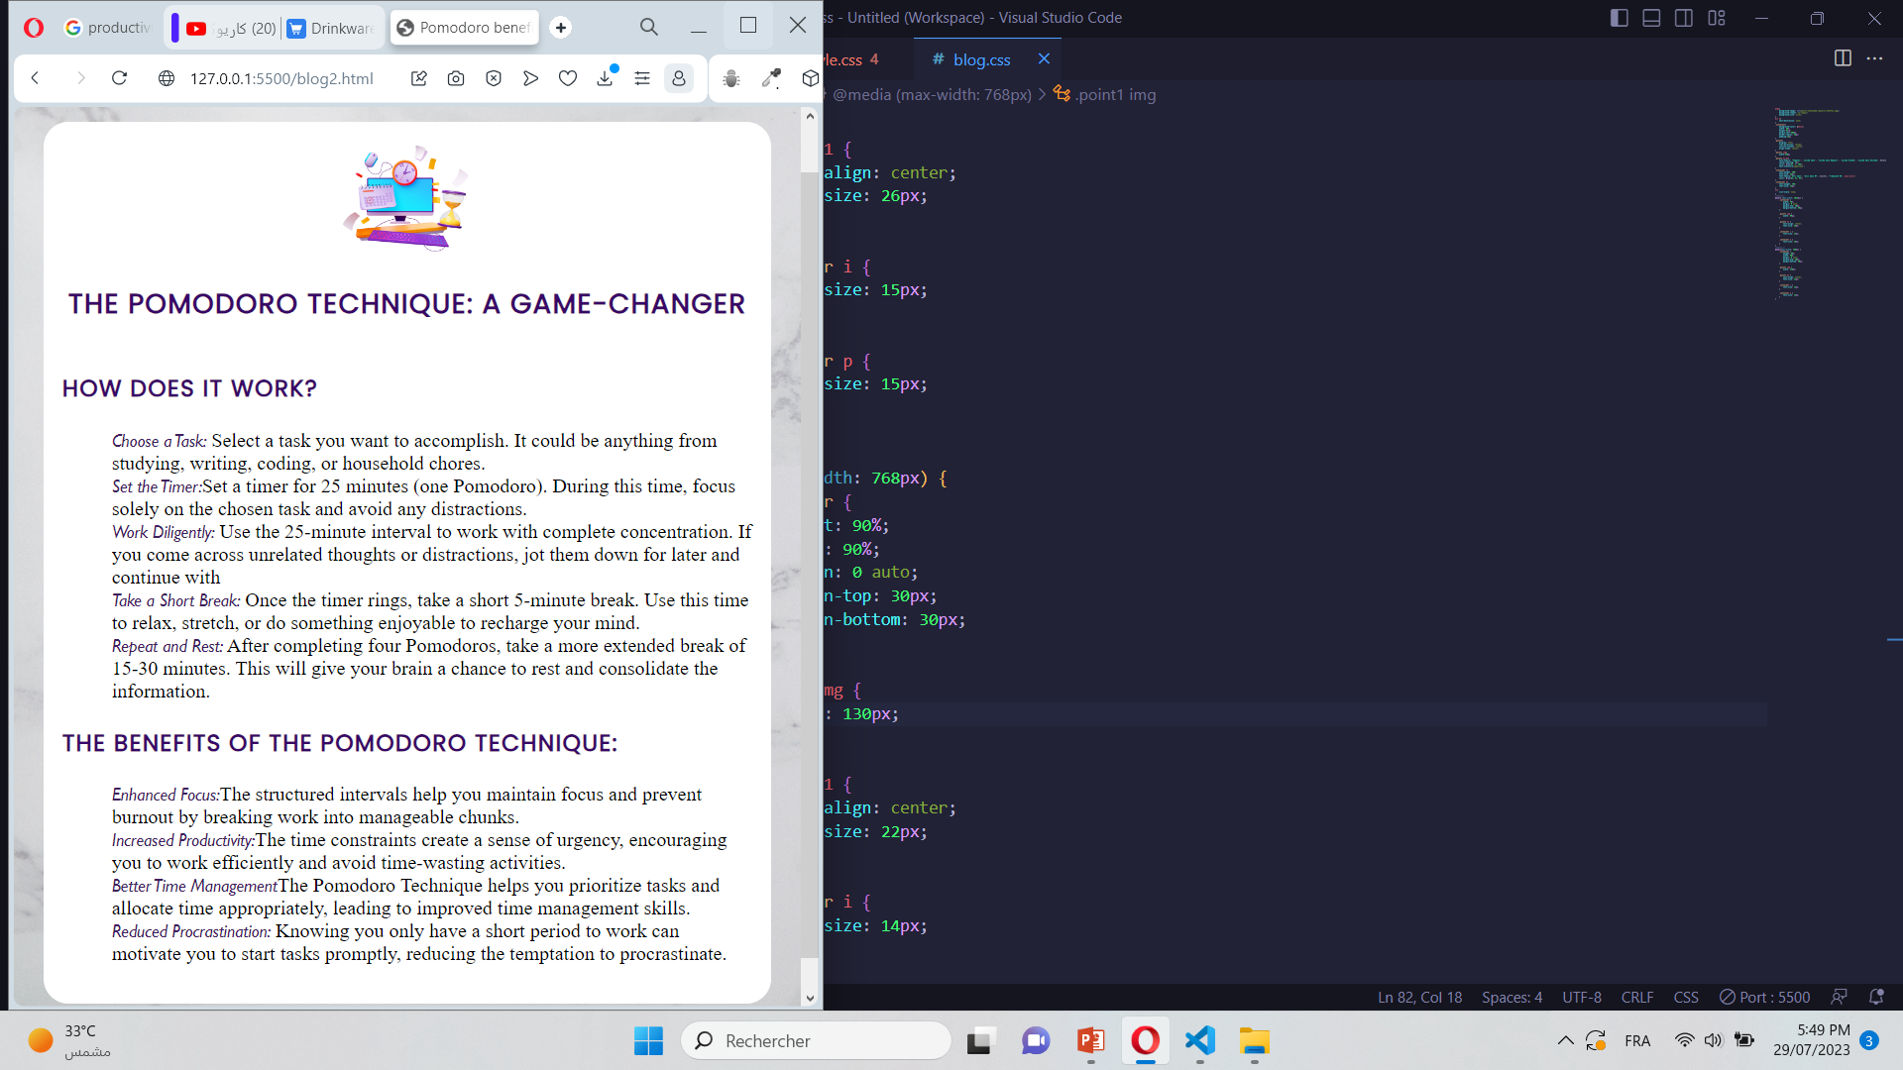
OUR BLOGS

Slide 15
DIFFICULTIES
03

Slide 16
BLOGS
Slides
Difficulties
DARK MODE
SERVICES
It used to be a quote generator where you can find motivationl quotes but the js script was too hard to code
It was kind of hard to understand the code since it used swiper js
I had background images,by adding a background color in dark more the images were still there.
I wanted to create a connection between my two services but it requiered advaced js.

Slide 17

Hope you enjoyed the presentation
I’m now open to yout questions

